Slide 1



What is Apriori Algorithm?
Veri Madenciliğine Giriş
http://youtube.com/bmdersleri
Prepared and Presented by: Melek Yılmaz
Date : 17/08/2021
Version : v1

Slide 2

Contents
Theoretical explanation of the Apriori algorithm
Implementation of the Apriori algorithm with python
Conclusion
resources
http://youtube.com/bmdersleri

Slide 3
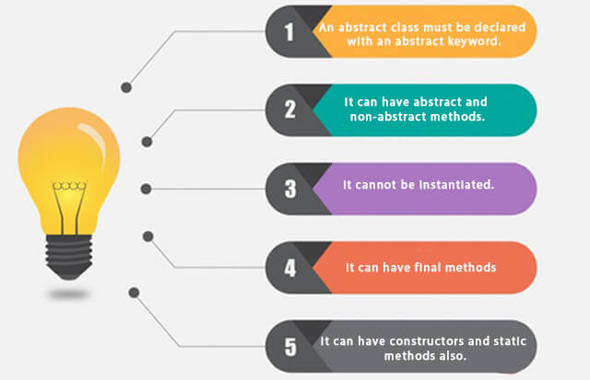
What are Association Theory Concepts?
The origin of the concept is based on shopping carts.
It is tried to make a profit by selling the products with the highest frequency of the products ordered one after the other, together with a campaign.
For example, if the number of people who order diapers and baby puree at the same time is more than the number of people who order diapers and shaving foam at the same time, it will be more profitable for us to sell diapers and baby food together with a campaign.
On the basis of the concept lies the question of 'Correlation is not Causation', that is, relationality or causality.
People's perception is about causality. 'Why did those who buy diapers buy baby porridge, what is the relationship between and how do we model this relationship mathematically and use it to our advantage?' we think of.

Slide 4
What are Association Theory Concepts?
Machine perception is 'If diapers and baby puree are sold together, sell together'. Without knowing why, he can find the relationship and turn it into action.
The concept we call ARM (Association rule mining) and ARL (Association rule learning) is based on this.
Association rule extraction tries to extract semantic relational values ​​from the database.
There are three concepts included.
1. Support Concept
2.Confidence Concept
3. Lift concept

Slide 5
What are Association Theory Concepts?
The concept of support is the percentage distribution of the people who performed the action we defined in the population that we can sample. For example, the support value of the action of purchasing product a is the ratio of the purchase of product a to the total number of actions.
The concept of Confidence is that the second action is dependent on the first action. The probability of those who buy product a to buy product b is also examined.
Note => The concept of support is sufficient when talking about a single action, namely the probability of receiving product a, but when we connect two actions, that is, when we try to capture the relationship between buying product a and receiving product b, we should use the concept of confidence.
The concept of lift investigates the effect of action a on action b.
The division of the probability of those who buy product a to buy product b to the total number of actions of buying product b gives the concept of lift.
If the lift concept is less than 1, it means that the purchase of product a affects the purchase of product b negatively.

Slide 6
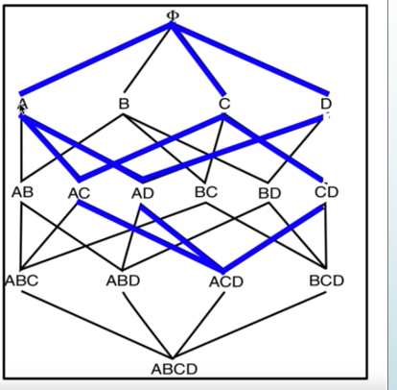
Event Frequency
It works on frequency.
Let's set a support value at the beginning.
Let's assume that we have four different actions, A, B, C and D, and look at the support values ​​of these actions one by one.
In the image, we eliminated it because the support value of the B action is less than the support value we set.
Since the maximum value that action B can achieve when paired with other actions cannot exceed the value it takes alone, we have also eliminated the continuation paths from action B.
We then look at the binary probabilities of actions that are not eliminated.
We combine actions A with C, A with D, and C with D.

Slide 7
Event Frequency
Here, too, if there were binaries with a support value below the support value we determined, we would have eliminated these pairs. Since the support values ​​were higher than the support value we determined, we did not eliminate any binary possibilities.
We create triple possibilities from AC, AD and CD actions. We would eliminate if the support values ​​of the triple possibilities were below the support value we determined, but we did not eliminate it because the support value of the formed ACD triple probability was above the support value we determined.
Proceeding in this way, we run the apriori algorithm.
The Apriori algorithm looks at the frequency of the actions in the system, how much they correspond as a percentage and eliminates those below a certain value.

Slide 8
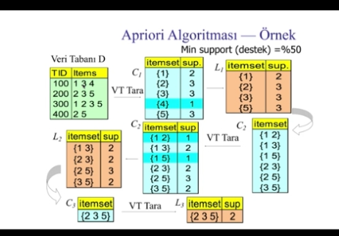
Explanation of Apriori Algorithm Through Example
Keep the records of the products in the receipts of the four people shopping in the database.
The support values ​​of the products kept in the database are calculated.
In the database, there are two products of 1, three of each of 2, 3 and 5, and 1 of 4 products. These numbers are support values.
In the example, the minimum support value is 50%.
The highest frequency in our database is 3.
50% of 3 becomes 1.5.
We will eliminate products with a support value below 1.5.
Since the support value of the product 4 is 1, we eliminate it.

Slide 9
Explanation of Apriori Algorithm Through Example
Our new frequency system will consist of 1,2,3 and 5 products.
We find the binary equivalents of these products. By combining products 1 and 2, products 1 and 3, products 1 and 5, we look at the support values ​​of all possible combination possibilities.
Since products 1 and 2 are mentioned together in our database only once, the support value is 1.
Since products 1 and 3 are mentioned together twice in our database, the support value is 2.
Since products 1 and 5 are mentioned together only once in our database, the support value is 1.
Since 2 and 3 products are mentioned together in our database twice, the support value will be 2.

Slide 10
Explanation of Apriori Algorithm Through Example
Since 2 and 5 products are mentioned together three times in our database, the support value is 3.
Since 3 and 5 products are mentioned together twice in our database, the support value is 2.
Our minimum support value was 1.5. We eliminate the combination of the 1st and 5th products with the combination of the 1st and 2nd products whose support value is below 1.5.
After the elimination process is over, we try to find the one with higher frequency among the remaining {1,3}, {2,3}, {2,5} and {3,5} pairs.
Since the frequency of the combination of products 2 and 3 is 2, the frequency of the combination of products 2 and 5 is 3, if we were to recommend a product to someone who bought product 2, we would recommend product 5.

Slide 11
Explanation of Apriori Algorithm Through Example
If you buy the 3rd item, we can recommend the 1st, 2nd and 5th items, because they all have the same frequency.
When we try to find a triple correspondence to the binary probabilities we have in the database, we see the possibility that only the 1st, 3rd and 4th products are together as the triple correspondence containing the first and third product in the database.
2.3 in the second and third rows of the database. and we see that the 5th products are repeated.
2nd and 5th in the last row. Since it does not create a triple possibility, we eliminate this possibility.
Back 2.3. The probability that the 5th and 5th products are combined remains.
The support value of this triple probability is two.
If we want to make a campaign from the three products that are sold together at most, if we package and sell the 2nd, 3rd and 5th products, we expect the demand to be higher.

Slide 12
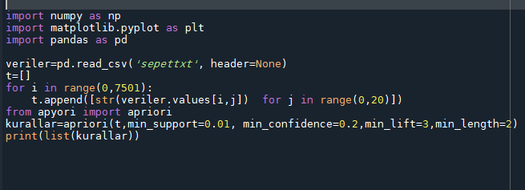
Implementation of Apriori Algorithm with Python
I will explain while writing the codes with Python.

Slide 13
Conclusion
Let's briefly summarize the issue.
The question of 'relationship or causality' lies at the heart of the association theory.
Relation is important as we are concerned with machine perception.
Machine perception can establish a relationship between events for which it does not know the reason, and can turn this relatedness into action.
Association theory includes basic concepts such as support value, confidence value, and lift value.
One of the algorithms that explains the association theory is the apriori algorithm.
The basis of the Apriori algorithm is the frequency of events.
It looks at the frequencies of the actions in the system and tries to provide the most advantageous combination.
Some areas where the Apriori algorithm is used are campaigns, behavior prediction, directed ARM, and time series analysis.

Slide 14
resources
https://www.btkakademi.gov.tr/portal/course/player/deliver/python-ile-makine-ogrenmesi-11800http://youtube.com/bmdersleri
http://youtube.com/bmdersleri

Slide 15
Thank you for your interest…
Veri Madenciliğine Giriş
http://youtube.com/bmdersleri
Prepared and Presented by: Melek Yılmaz
E-mail: Melek_yilmaz_1997@hotmail.com
Date :17 /08/2021
Version : v1

